Slide 1

AGRICULTARAL DATA MANAGMENT
SUBMITER BY : Md Asif Hossain
ID:180201015

Slide 2
AGRICULTARAL DATA MANAGMENT
GROUP MEMBERS:
Md Asif Hossain
ID: 180201015
SUPERVISOR :
Md. Sydur Rahman
Designation: Lecturer
Department: Computer Science & Engineering

Slide 3

Why we Choose This Project?
Bangladesh is the main country of agriculture where 70% of the people live through agricultural activities but most of them do not know how to do agricultural work in a scientific way through which we can learn to do scientific farming through this Agricultural Data Management. We want to be able to connect with our new information databases for Everyone.

Slide 4
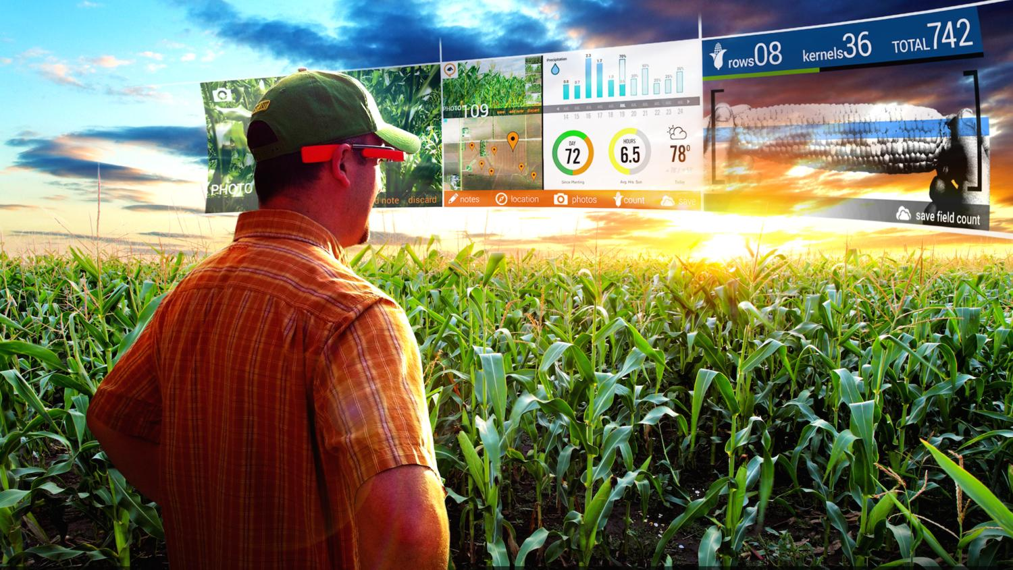
What is Agricultural Data Management?
Agricultural data management is a repository of various agricultural data. Through this, the common people and farmers will get information about agriculture. Farmers will be most beneficial because, here scientific information on how to cultivate a new crop, how to cultivate a crop at any time and profit in a short time will be available.

Slide 5
How I Execute This Project?
I used C programming language to do my project, my technology is agricultural data management so here I have to add a lot of data in files. I have added three crop data files to my project's program so that the user can collect the required data through this technology.

Slide 6
ALGARITHOM
STEP 1: Start Program.
STEP 2: Input.
STEP 3: Check Availibity
If(input==crop)
(i) Yes, Go to next Step.
(ii) No, Go to Step 2.
STEP 4: Check and Find The Result.
STEP 5: Print Result.
STEP 6: End Program.

Slide 7
FLOW CHART
START PROGRAM
INPUT
CHECK
AVAIBILITY
YES, Go to Next Step
NO
Check & Find The Result
Print RESULT
END PROGRAM

Slide 8
FUTURE WORK
With this technology, the farmers and the general public of our country will know a lot about agriculture in our country. With this project, farmers will know the way to produce new scientific crops in future. If we work more with this project .In Future update will add new technologies and new information

Slide 9
CONCLUSION
Bangladesh is the main country of agriculture. Here 80% of the people are related to agriculture in some way. In order to improve Bangladesh, agriculture must first be given priority. So I think this project will help us a lot in the development of our country.

Slide 10
Thanks For Watching
My Presentation

